Slide 1
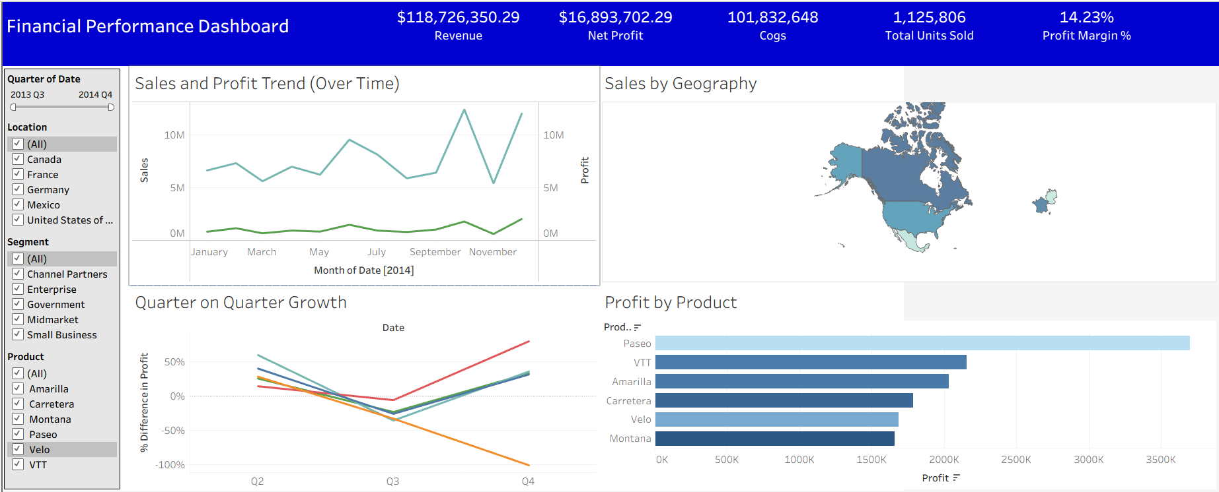
Financial Performance Dashboard – Business Performance Overview
Key Sales & Profitability Insights for Stakeholders
Prepared by Aakash Rajivale, Jr. Business Analyst

Slide 2
Executive Summary
Purpose
Key Metrics Achieved
Provide an at-a-glance view of company sales and financial performance, identifying growth opportunities, top-performing markets, and profitability drivers.
Total Revenue: $118,726,350.29
Net Profit: $16,893,702.29
Profit Margin: 14.23%
YoY Growth: 235.5%

Slide 3
KPI Overview: Understanding Our Core Metrics
To provide a comprehensive overview of our financial health, we monitor several key performance indicators. These KPIs offer actionable insights into our operational efficiency and market position.
Total Sales
1
Represents the overall revenue generated from all product and service offerings before any deductions.
Net Profit
2
Calculated as earnings after subtracting the cost of goods sold (COGS), operating expenses, and taxes from total revenue.
Profit Margin %
3
Indicates the percentage of revenue that translates into net profit, highlighting the efficiency of our pricing and cost management strategies.
Year-over-Year Growth %
4
Compares current period performance against the same period in the previous year, providing a clear picture of our growth trajectory.

Slide 4
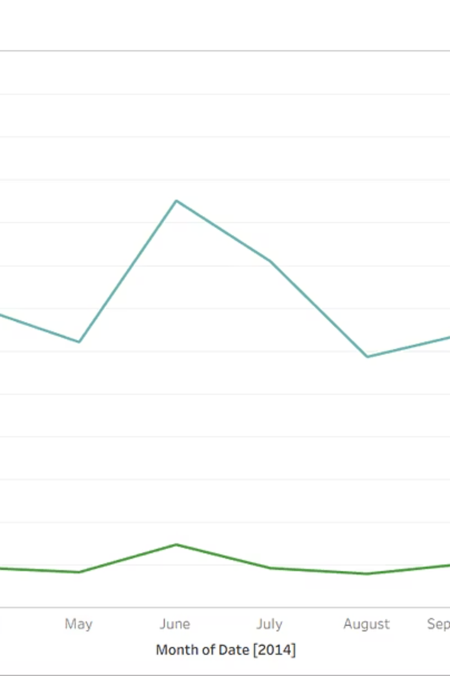
Sales & Profit Trends: Identifying Seasonal Patterns
Analyzing monthly and yearly trends for sales and net profit helps us identify seasonality and growth patterns. This enables us to plan inventory, optimize marketing campaigns during peak months, and prepare for potential downturns.

Slide 5

Regional Performance: Market Share & Revenue Concentration
Understanding total sales by country and region is crucial for identifying market share and revenue concentration. This allows us to pinpoint high-growth areas and address underperforming regions with targeted strategies. The choropleth map below visually represents sales intensity across different geographies.

Slide 6
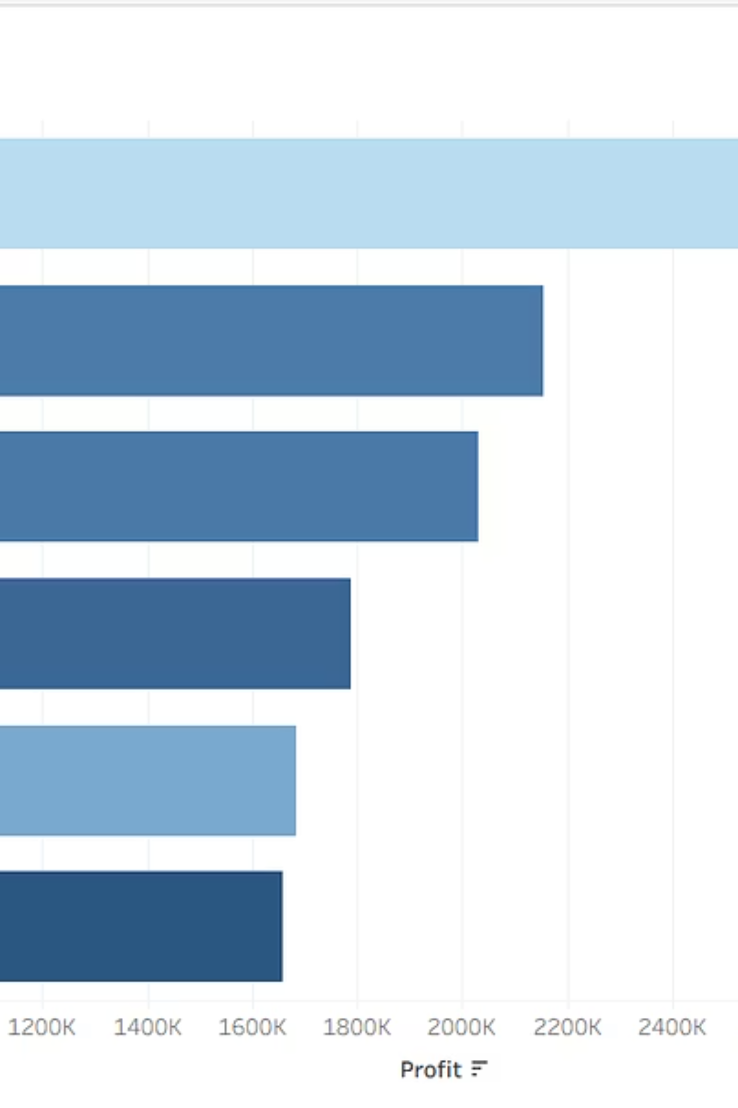
Product Performance: Identifying Profitability and Leaders
Examining the top and bottom 5 products by sales and profit margin provides critical insights into our product portfolio. This data supports informed decisions on pricing, promotions, and product development to maximize overall profitability.

Slide 7
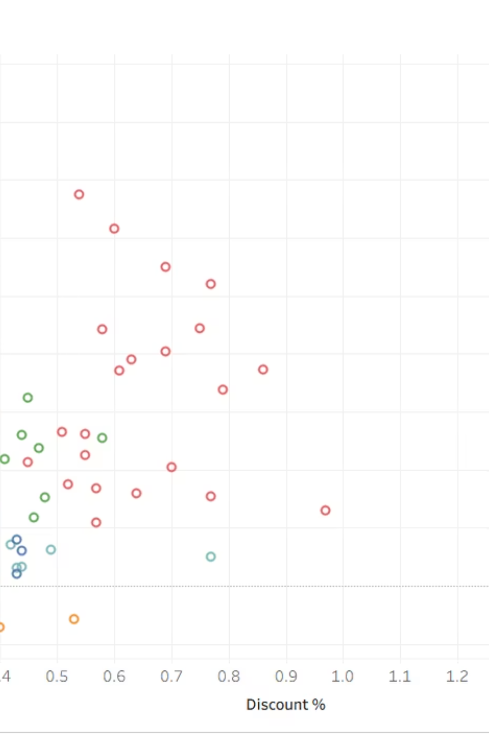
Discount Impact Analysis: Optimizing Promotional Strategies
Analyzing the relationship between discounts and net profit helps us evaluate whether promotional activities are effectively boosting sales or inadvertently eroding profit margins. The scatter plot illustrates this crucial balance, guiding future discount policies.

Slide 8
Strategic Recommendations for Sustainable Growth
Regional Marketing Focus
Pricing Strategy Review
Concentrate marketing efforts and resource allocation in top-performing regions to capitalize on existing market strength and accelerate growth.
Re-evaluate pricing for low-margin products to ensure they contribute adequately to overall profitability or consider product discontinuation.
Optimize Discount Policies
Resource Allocation to High-Growth Products
Implement refined discount policies that balance sales generation with profit margin protection, ensuring promotions are strategically beneficial.
Direct increased investment and operational focus towards product lines demonstrating high growth potential and strong profitability.

Slide 9

"Data-Driven Decisions Lead to Sustainable Growth"

